Slide 1
Humanities 101
An Introduction

Slide 2
Class Business
Who am I?
What can you expect of me?
What do I expect from you?

Slide 3
What is Humanities?

Slide 4

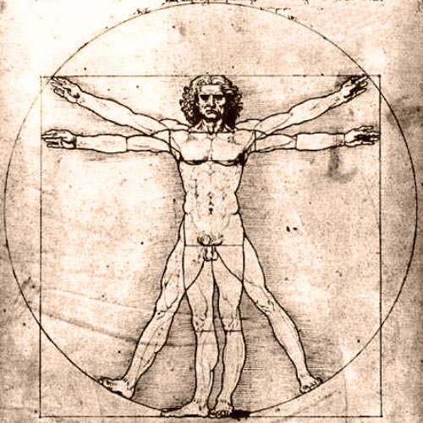

What Are the Humanities?
“An education befitting a cultivated man.”
Academic disciplines that study the human condition.
ITS CULTURE

Slide 5

What are the Humanities Comprised Of?

Slide 6
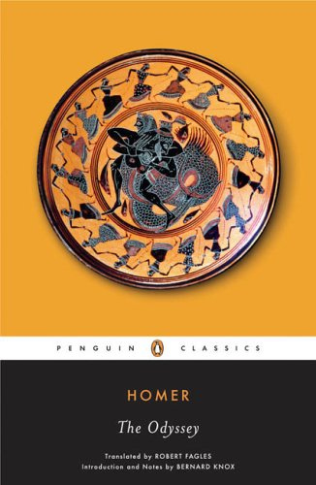





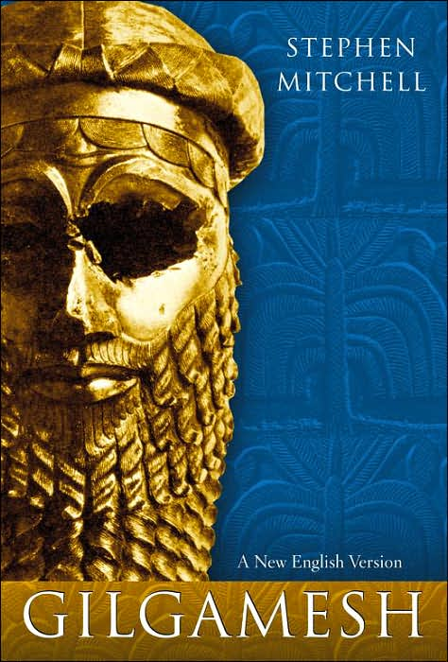
Notes:
What are you reading?
Holy Bible
Epic of Gilgamesh- world’s first epic recounting the deeds of a hero on a quest of meaning and identity. 2800 BCE
The Odyssey by Homer- national poems of ancient Greece about journey of hero Odysseus and his quest for honor and glory
Confucius- philosopher of the Zhou era and China’s most noteable thinker. Author of “Analects,” the embodiment of the words of Confucius regarding everything from music, to marriage to the proper behavior of the society at large.
The Hindu Vedas- India’s oldest devotional texts, a collection of prayers, sacrificial formula, and hymns.
Antigone- Greek play written by Sophocles exploring the conflict of rights between the individual and the state.

Slide 7
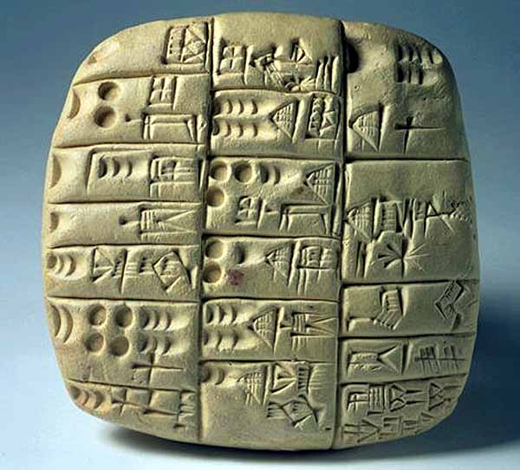

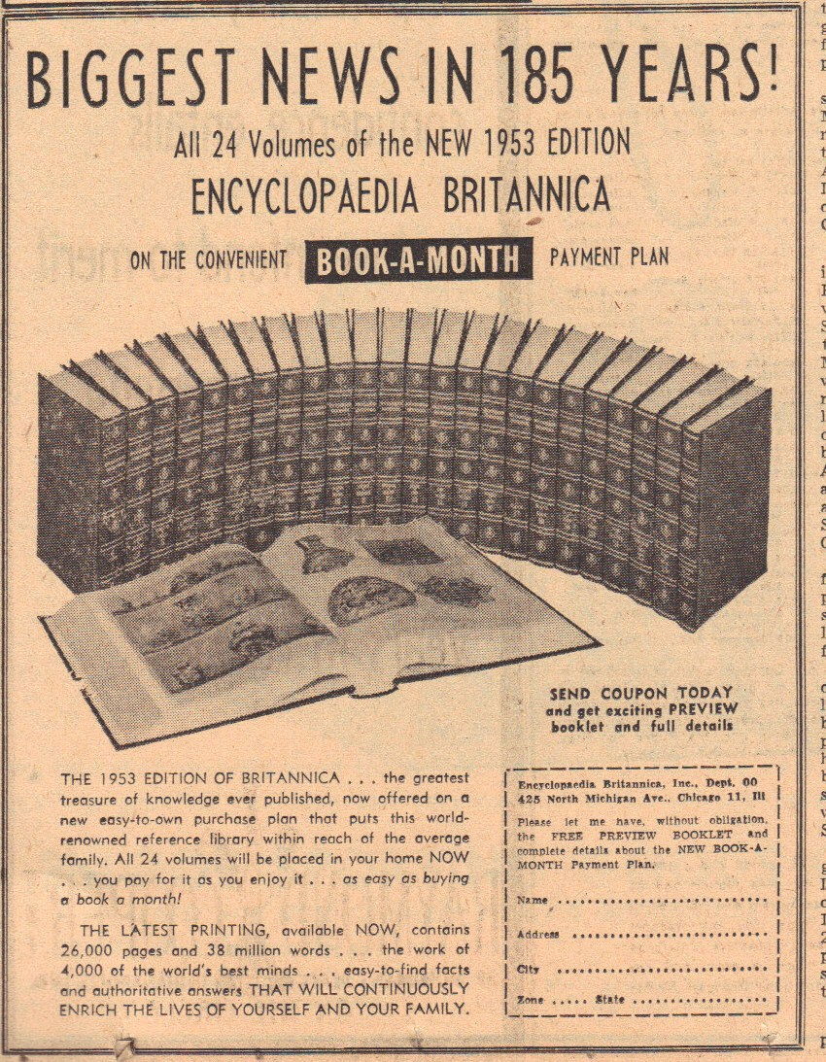

Slide 8

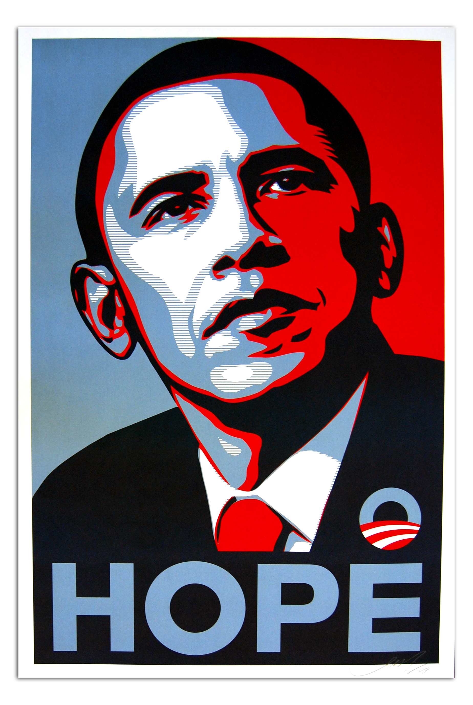
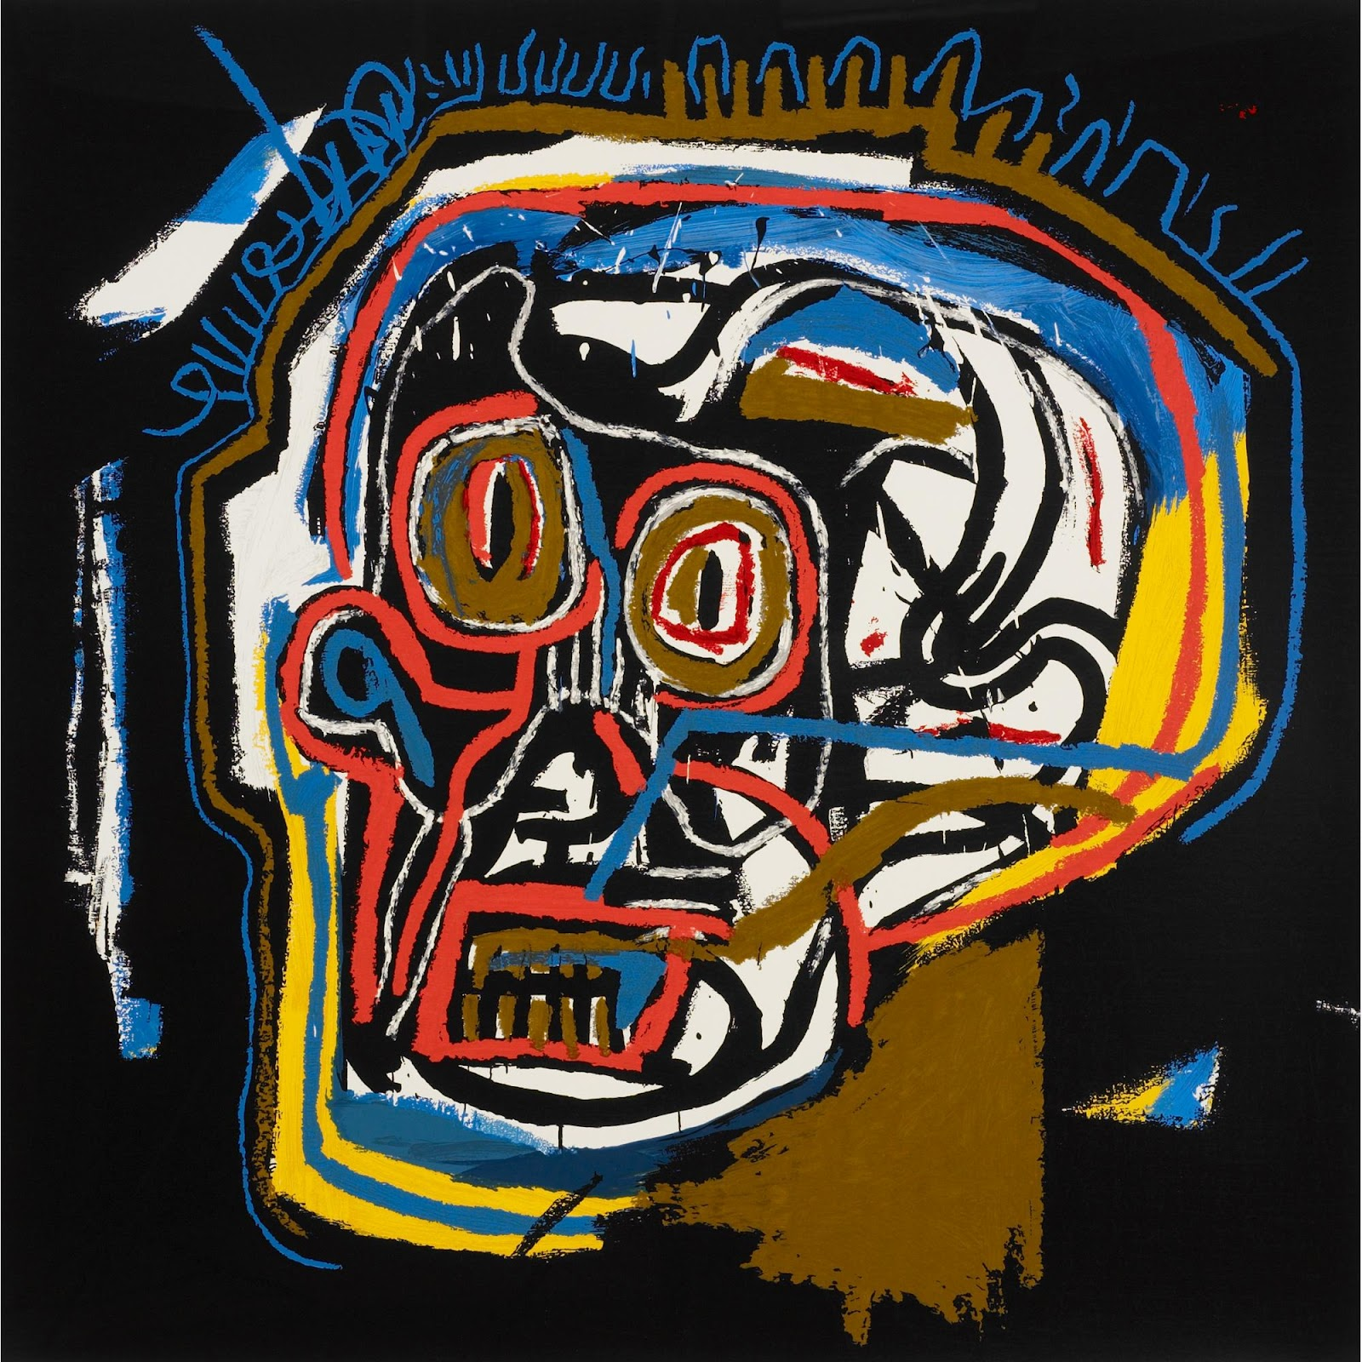
Notes:
What artists of today do you relate to?
Basquait, post modern artist, NYC
Fairey, of OBEY fame and Obama’s HOPE posters

Slide 9



Slide 10
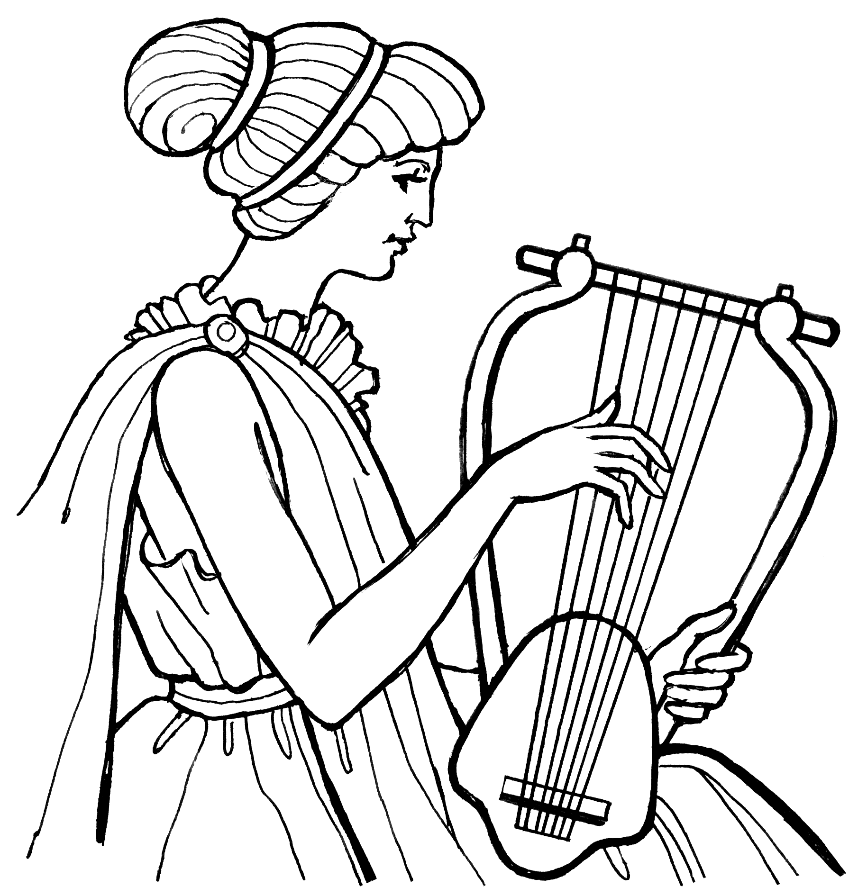
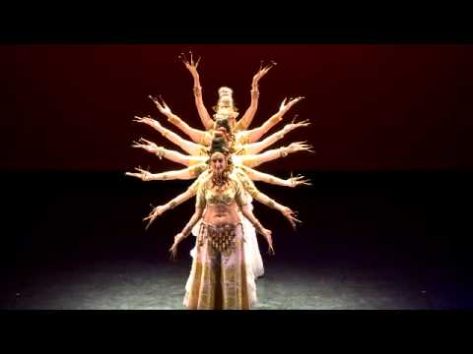
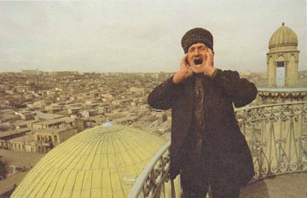
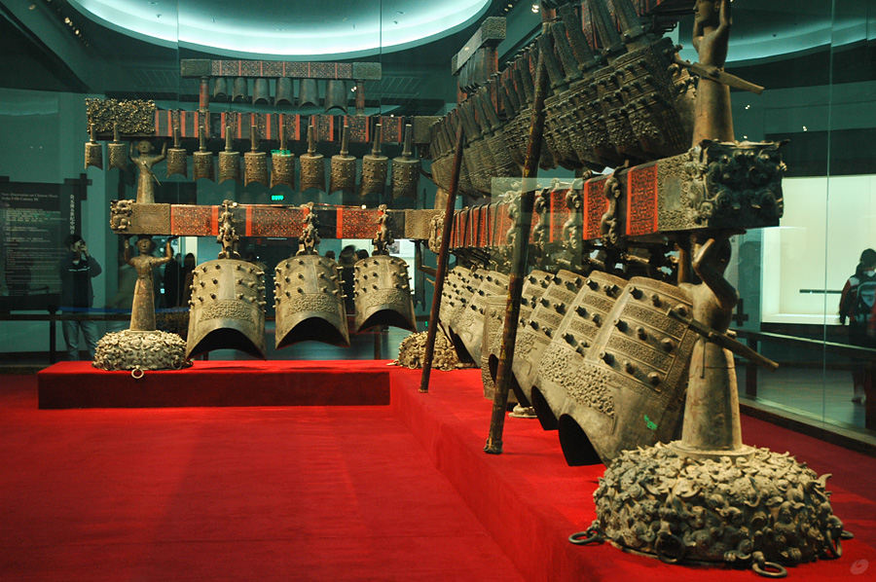
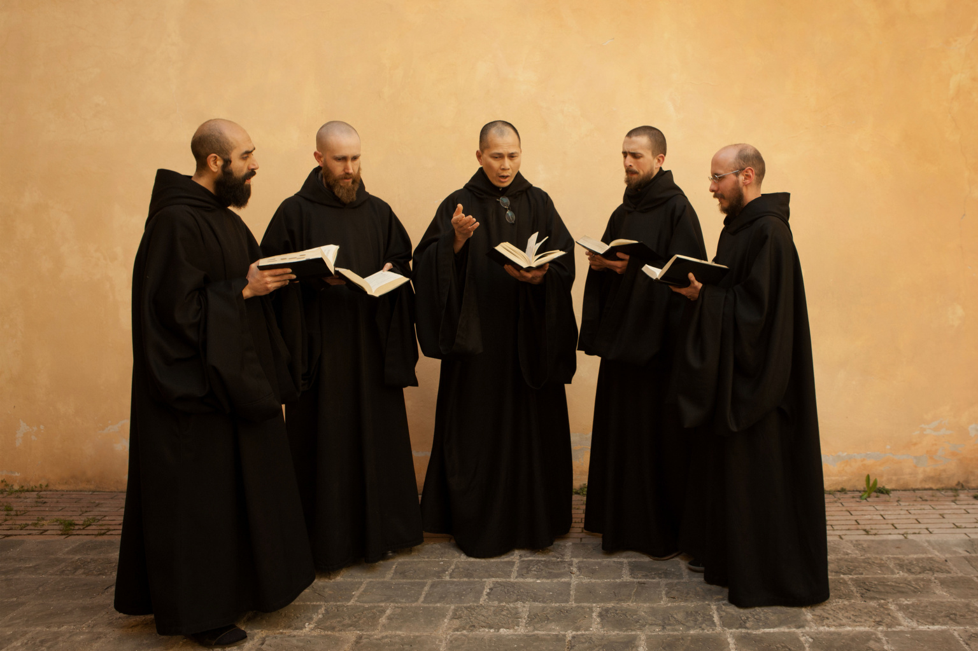
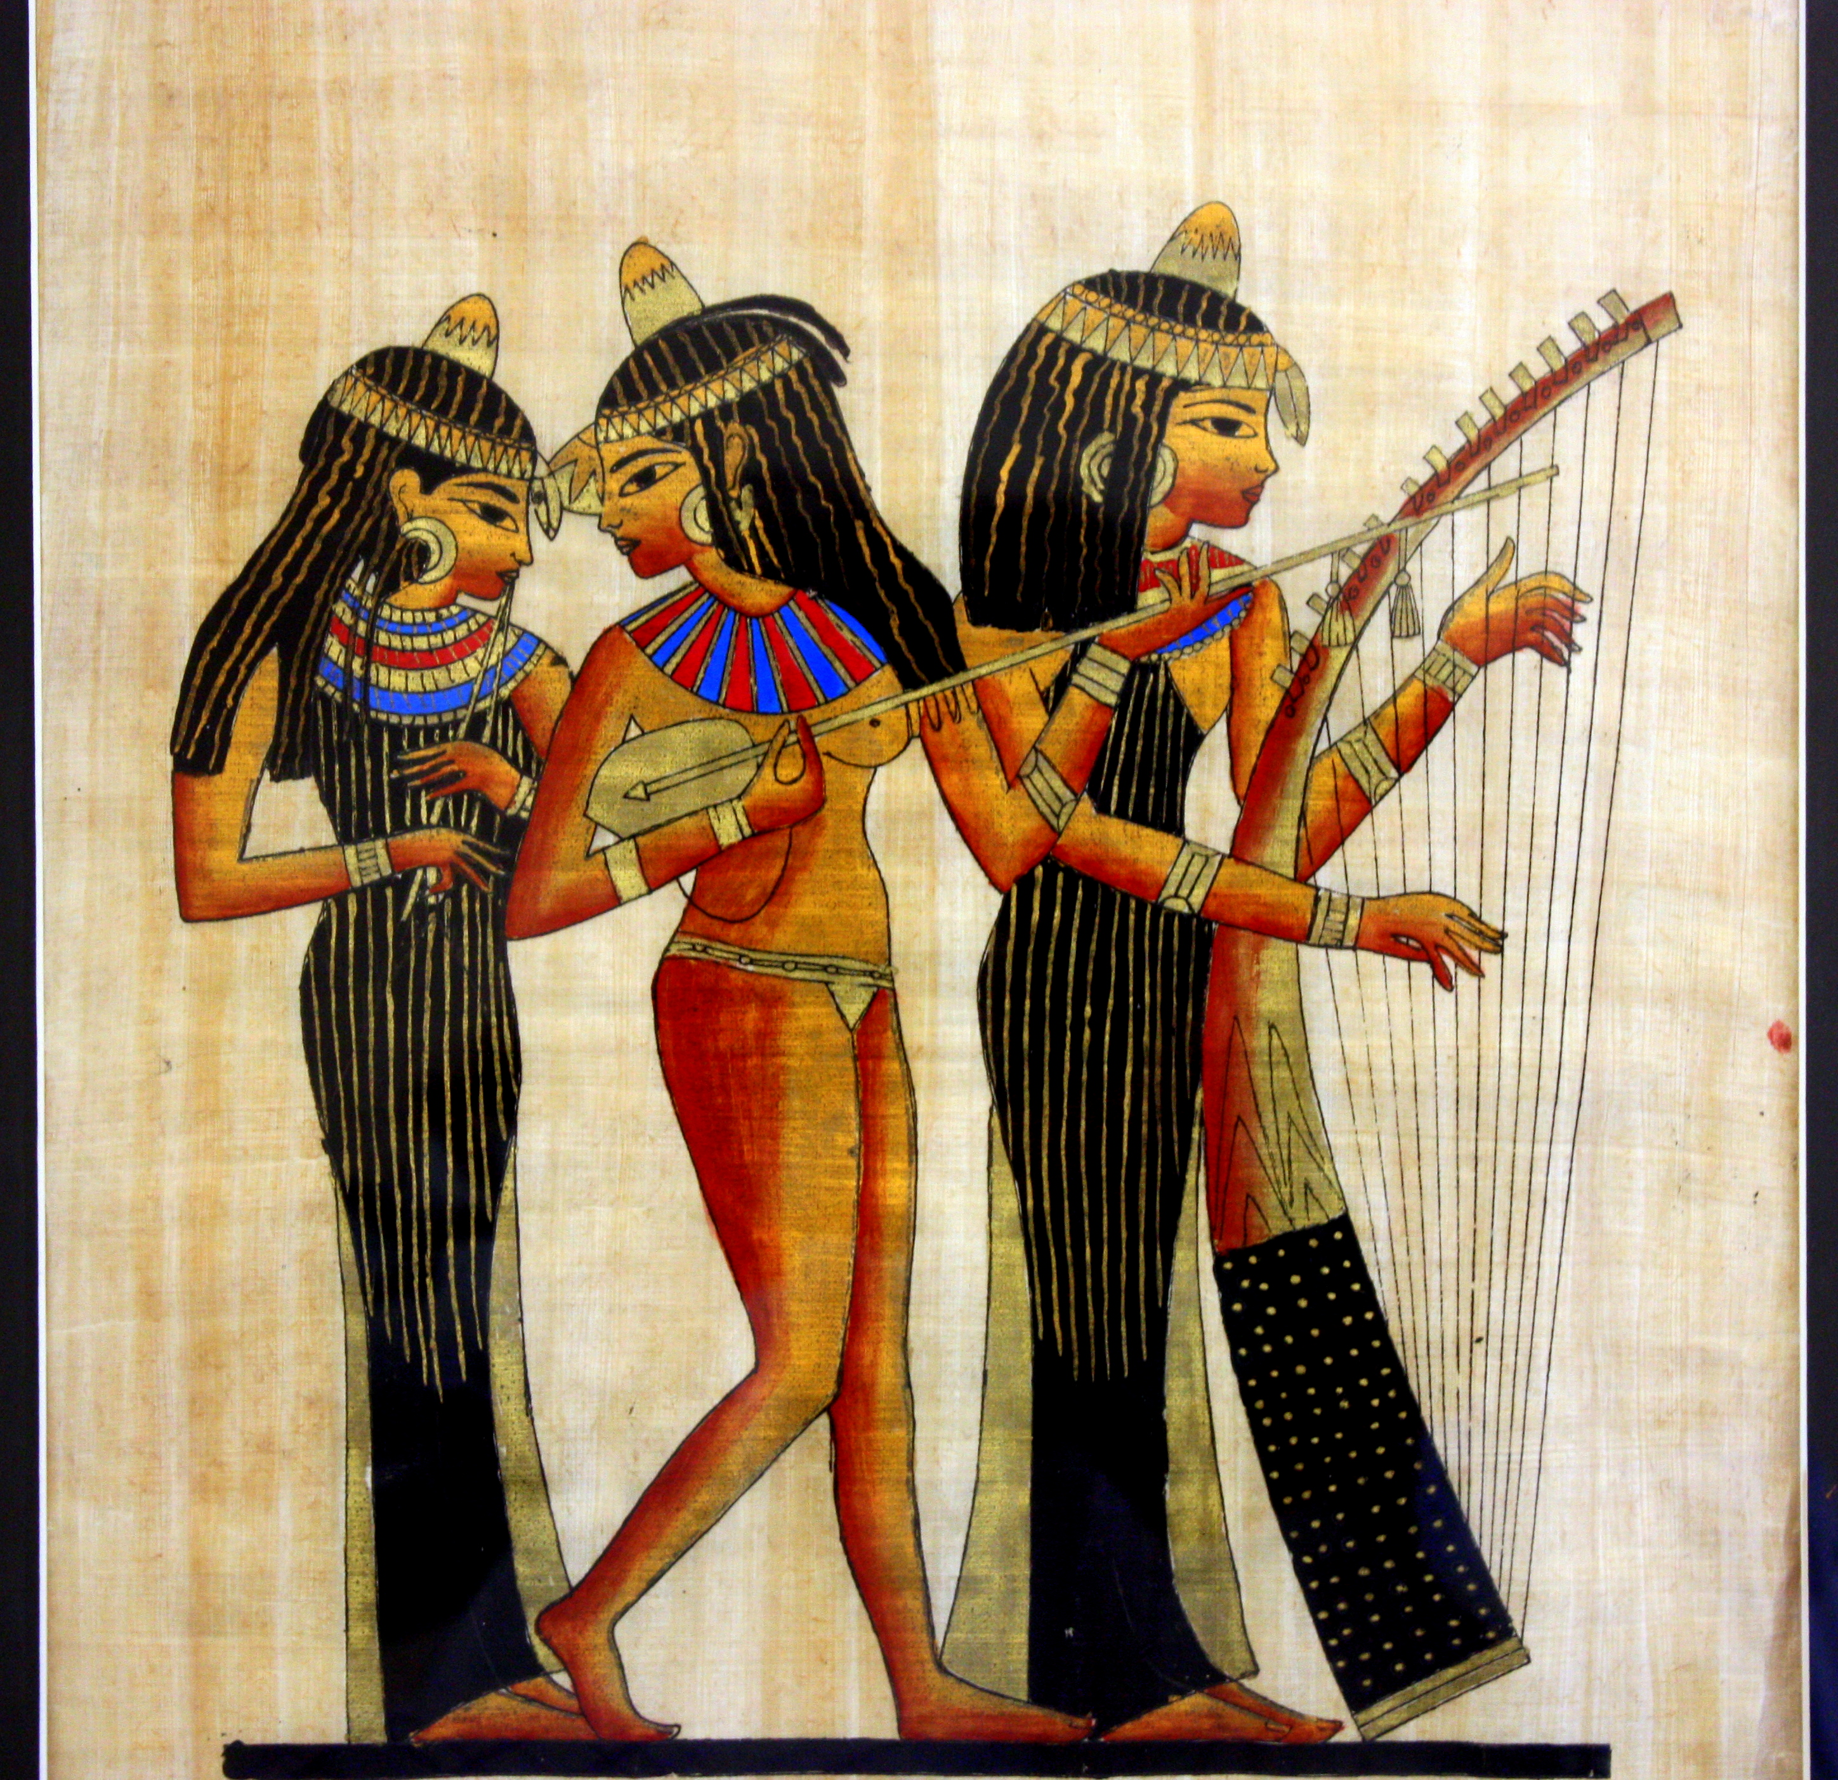

Slide 11



Slide 12
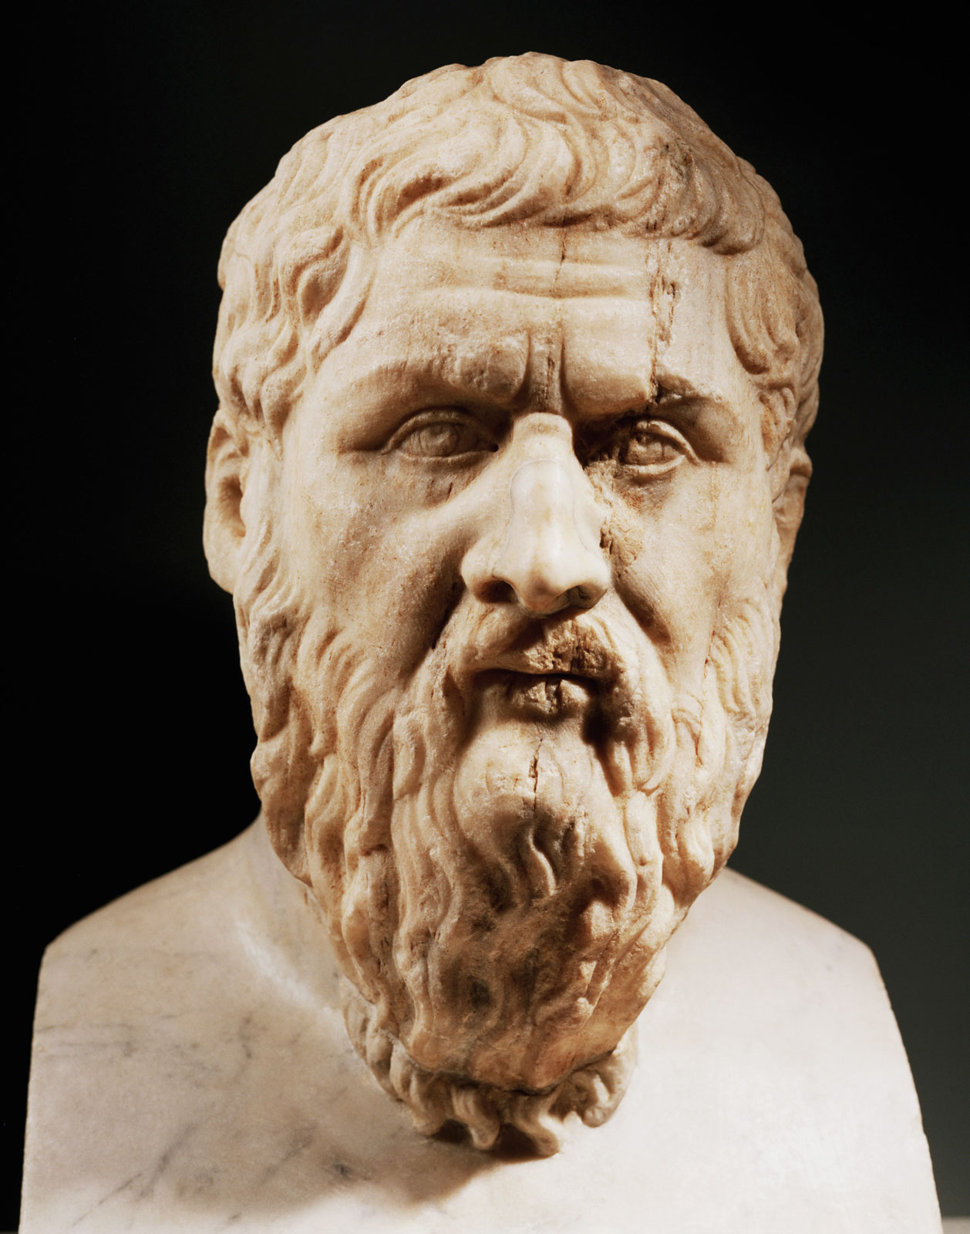
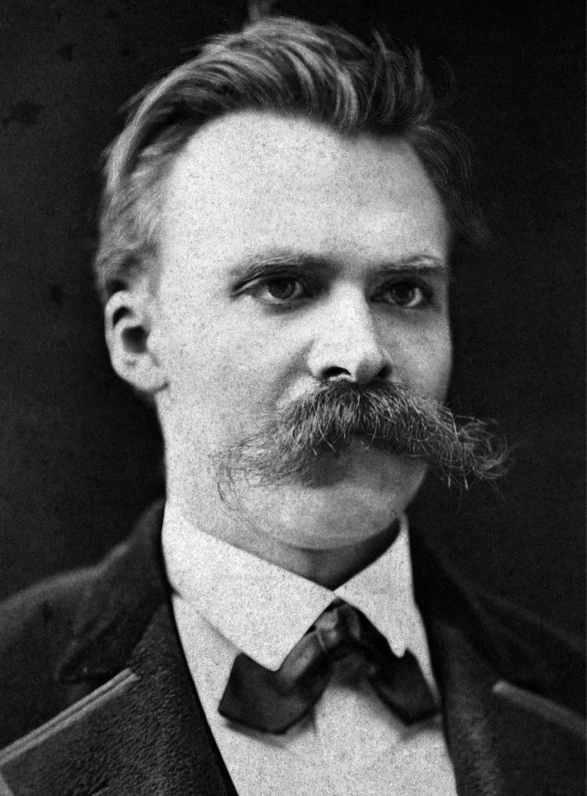
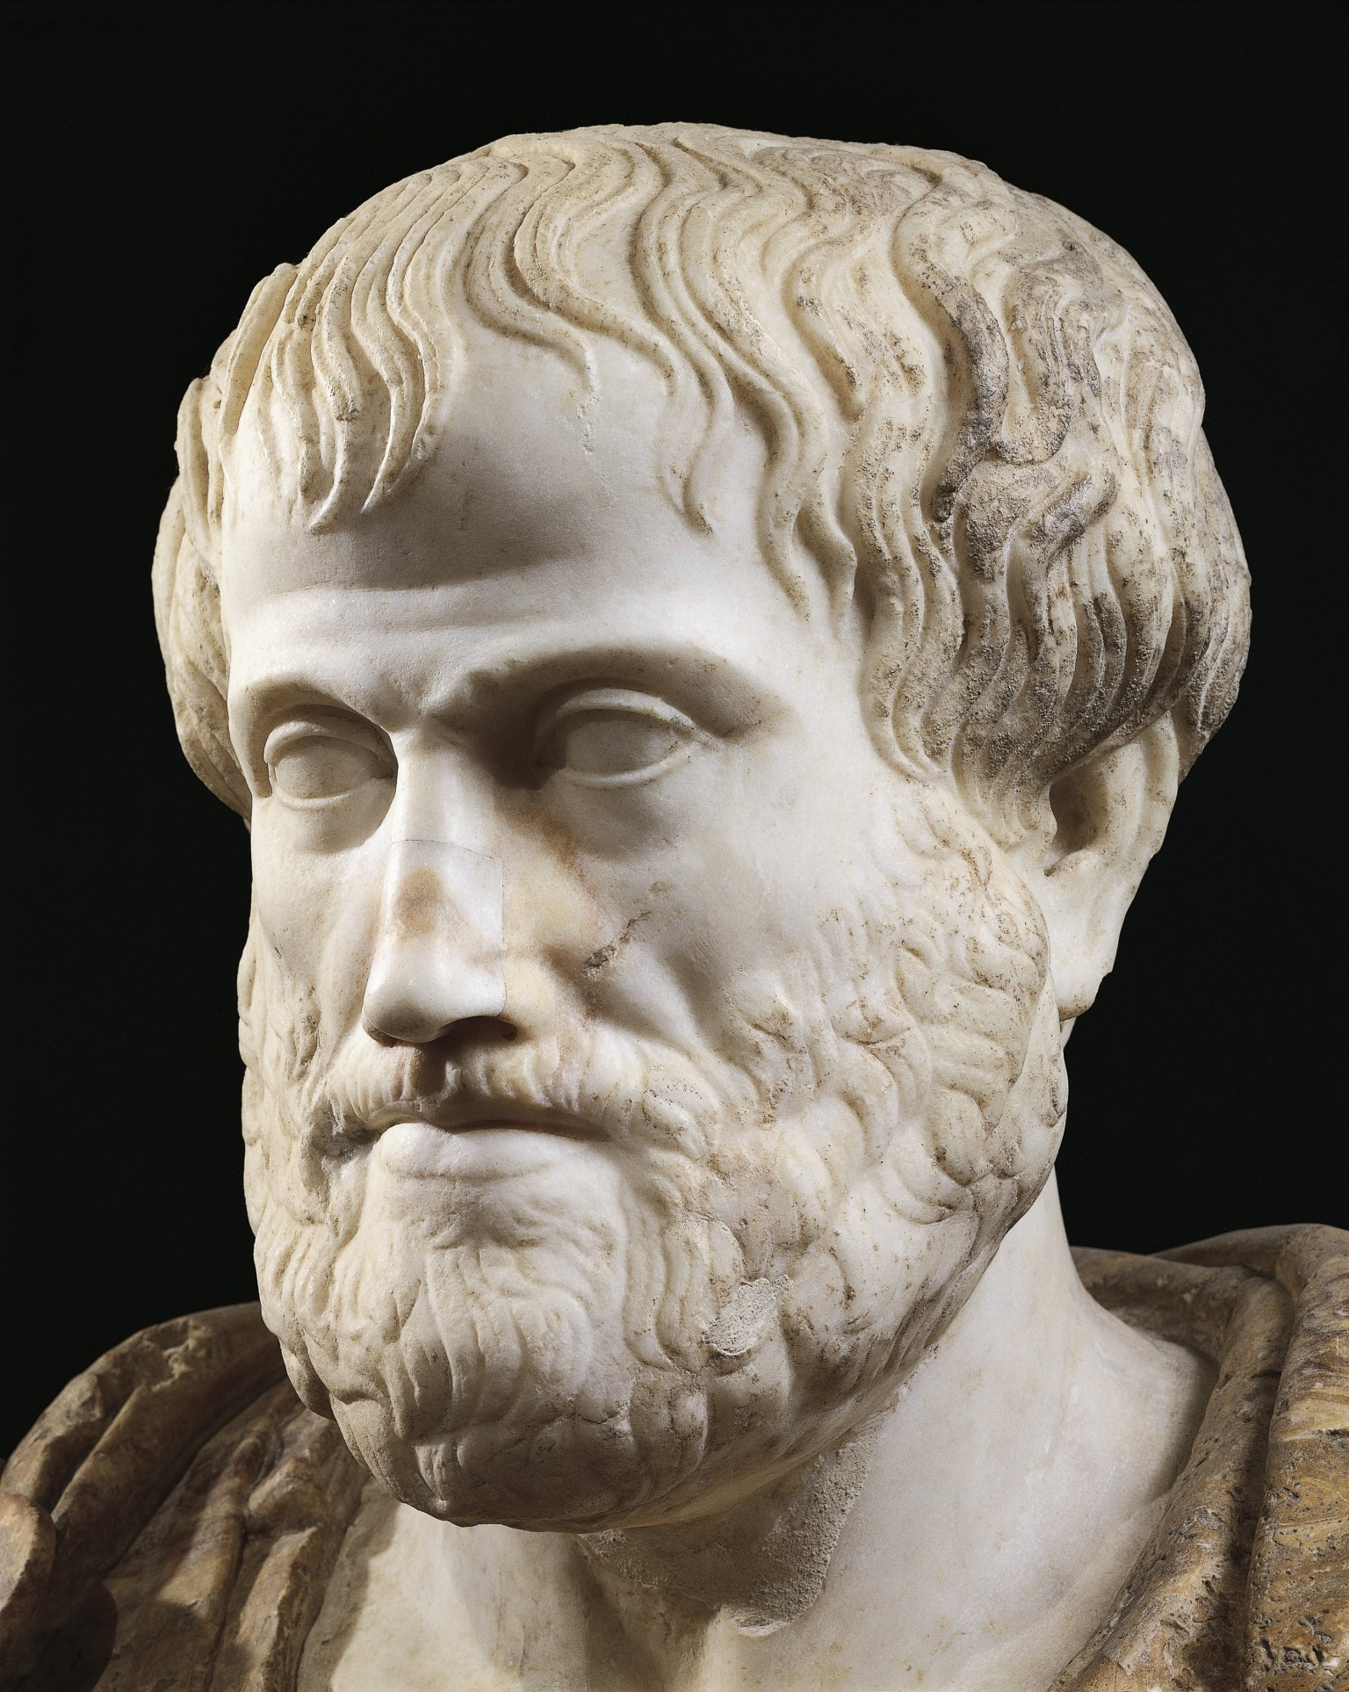
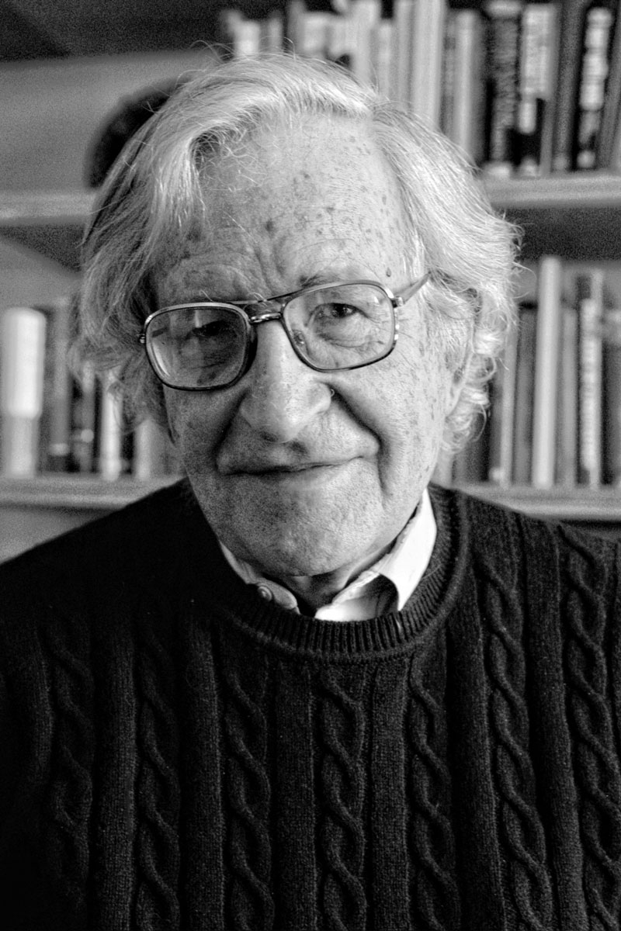
Notes:
Plato- The Republic. Regarding the meaning of justice and the nature of a just society
Aristotle- large contributions to the field of ethics, the branch of philosophy that sets the principals of human conduct.
Nietzsche- German 19th century philosopher. Key ideas include perspectivism, will to power, and master-slave mentality.
Noam Chomsky- 21st century American philosopher, the “Father of Modern Linguistics.” Focus on analytic philosophy.

Slide 13
How do we document and study these various areas?
Through Primary Sources which are texts- but not as we normally imagine
    Works original to the age in which they were produced
    Can be literary (read), visual (seen), or aural (heard)- it is the medium!

Slide 14
Context
The historical and cultural environment of a text
What time and place did our primary source originate?
How did it function within the society in which it was created?
Was it primarily decorative, didactic (designed to teach), magical or propagandistic?
Did is serve the religious or political needs of the community?

Slide 15
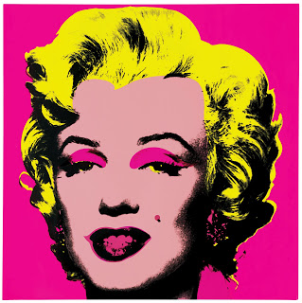


Subtext
Refers to the secondary or implied meaning of a primary source
Discloses conceptual messages embedded in or implied by the text

